Slide 1

What are Obstacles to open science in academic research?
Elizabeth B. Claus, MD, PhD
Professor
Yale School of Public Health
Attending Neurosurgeon and Director of Stereotactic Radiosurgery
Department of Neurosurgery
Brigham and Women’s Hospital

Slide 2
OPEN DATA =………..
Computer Code
Statistical Methods
Research Study Results
….

Slide 3
Release of ACADEMIC Research Study Data
Upside
Downside
Possible direct impact on clinical care
More researchers have access to data, potentially increasing efficiency and rate of discovery
Allows for reproducibility of results
Use of pre-existing data may reduce cost/maximize benefit of funding
Reduce study overlap or redo (null results not always published)
Educates junior (and senior) researchers
Encourages diverse analytic/programming techniques
Loss of control for the data collector who may have spent years gathering data-”Getting scooped”
Lack of incentive (financial, promotional) for faculty, academic centers and companies
Possible privacy issues for patients
Expenses of data transfer and upkeep

Slide 4




So what are the current “rules” and who sets these rules? IssUE-many rules set by many organizations

Slide 5
Any efforts to harmonize?
1997-U.S. Food and Drug Administration requires clinical trials to register at ClinicalTrials.gov
European Medical Agency begins to increase public access to clinical trial data-allows for release of participant level data
U.S. generally treats participant-level data as proprietary data owned by institution that collected it (NIH variation-offer sample consents/guidelines etc)
Feb 2016 Journal Editors-14 member International Committee of Medical Journal Editors (ICMJE)
Dissenting opinion August 2016 another consortium (282 investigators in 33 countries)
2015: Science: Center for Open Sciences’ Transparency and Openness Promotion (TOP) Committee propose journals graded from 0-3 based on commitment to Open Science

Slide 6
NIH Data Sharing Policy and Implementation Guidelines
Goals of Data Sharing
Applicability
Implementation
Timeliness of Data Sharing
Human Subjects and Privacy Issues
Proprietary Data
Methods for Data Sharing
Data Documentation
Funds for Data Sharing
https://grants.nih.gov/grants/policy/data_sharing/data_sharing_guidance.htm#goals

Slide 7
NIH Data Sharing Policy and Implementation Guidelines
Goals of Data Sharing
“In NIH's view, all data should be considered for data sharing…widely and freely available as possible while safeguarding the privacy of participants, and protecting confidential and proprietary data...investigators submitting a research application requesting $500,000 or more of direct costs in any single year to NIH on or after October 1, 2003 are expected to include a plan for sharing final research data for research purposes, or state why data sharing is not possible.”
https://grants.nih.gov/grants/policy/data_sharing/data_sharing_guidance.htm#goals

Slide 8
NIH Data Sharing Policy and Implementation Guidelines
Applicability
“To the sharing of final research data for research purposes.
To basic research, clinical studies, surveys, and other types of research supported by NIH. It applies to research that involves human subjects and laboratory research that does not involve human subjects. It is especially important to share unique data that cannot be readily replicated.
Policies with respect to data sharing vary across countries.”
https://grants.nih.gov/grants/policy/data_sharing/data_sharing_guidance.htm#goals

Slide 9
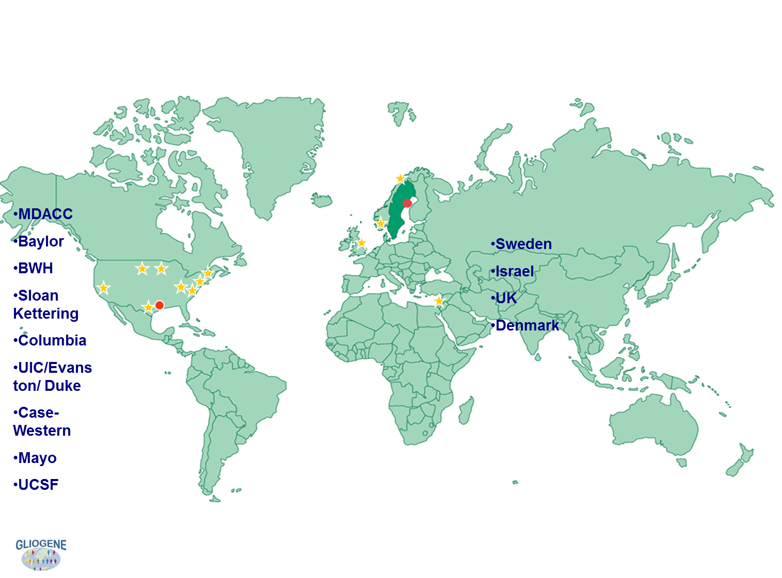

Slide 10
NIH Data Sharing Policy and Implementation Guidelines
Implementation
“Given the breadth and variety of science that NIH supports, neither the precise content for the data documentation, nor the formatting, presentation, or transport mode for data is stipulated.
For the most part, NIH makes awards to institutions and not individuals (with very few exceptions, such as F32 awards). Thus, the grantee institution may have additional policies and procedures regarding the custody, distribution, and required retention period for data produced under research awards.”
https://grants.nih.gov/grants/policy/data_sharing/data_sharing_guidance.htm#goals

Slide 11
NIH Data Sharing Policy and Implementation Guidelines
Timeliness of Data Sharing
“NIH expects the timely release and sharing of data to be no later than the acceptance for publication of the main findings from the final dataset. The specific time will be influenced by the nature of the data collected.
NIH recognizes that the investigators who collected the data have a legitimate interest in benefiting from their investment of time and effort. NIH continues to expect that the initial investigators may benefit from first and continuing use but not from prolonged exclusive use.”
https://grants.nih.gov/grants/policy/data_sharing/data_sharing_guidance.htm#goals

Slide 12
How Freely Should Scientists Share Their Data?
The Open Science movement champions transparency, but how much and how quickly is a matter of dispute
By Daniel Barron (Psychiatry resident at Yale!)
on August 13, 2018
Scientific American
February 2, 2016 NEJM
Sharing Clinical Trial Data
A Proposal From the International Committee of Medical Journal Editors
Darren B. Taichman, MD, PhD¹; Joyce Backus, MSLS²; Christopher Baethge, MD³; et al
“As a condition of consideration for publication of a clinical trial report in our member journals, the ICMJE proposes to require authors to share with others the deidentified individual-patient data (IPD) underlying the results presented in the article (including tables, figures, and appendices or supplementary material) no later than 6 months after publication.”
Perspective
August 4, 2016 NEJM 2016; 375:405-407
DOI: 10.1056/NEJMp1605654
Toward Fairness in Data Sharing
The International Consortium of Investigators for Fairness in Trial Data Sharing. “We believe that this interval is too short…We propose that study investigators be allowed exclusive use of the data for a minimum of 2 years after publication of the primary trial results and an additional 6 months for every year it took to complete the trial, with a maximum of 5 years before trial data are made available to those who were not involved in the trial”

Slide 13
NIH Data Sharing Policy and Implementation Guidelines
Human Subjects and Privacy Issues/Methods for Data Sharing
“Investigators may use different methods to reduce the risk of subject identification. One possible approach is to withhold some part of the data. Another approach is to statistically alter the data in ways that will not compromise secondary analyses but will protect individual subjects' identities.
Alternatively, an investigator may restrict access to the data at a controlled site, sometimes referred to as a data enclave. Some investigators may employ hybrid methods, such as releasing a highly redacted dataset for general use but providing access to more sensitive data with stricter controls through a data enclave.”
https://grants.nih.gov/grants/policy/data_sharing/data_sharing_guidance.htm#goals

Slide 14
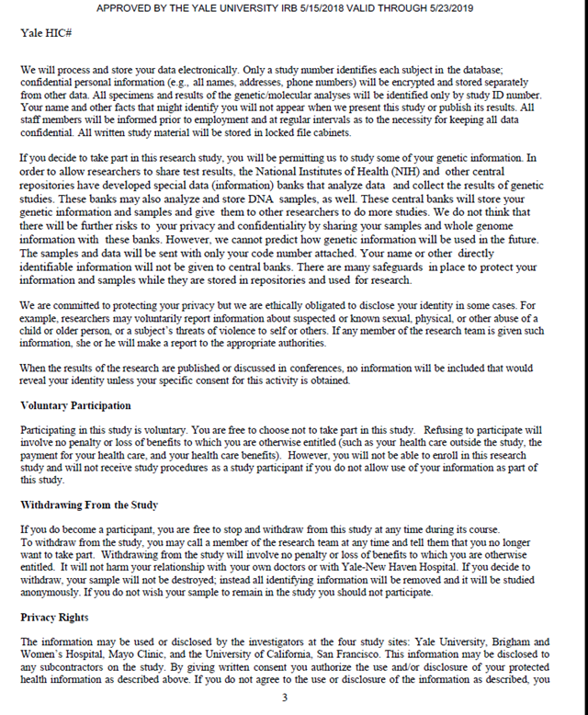
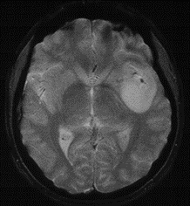
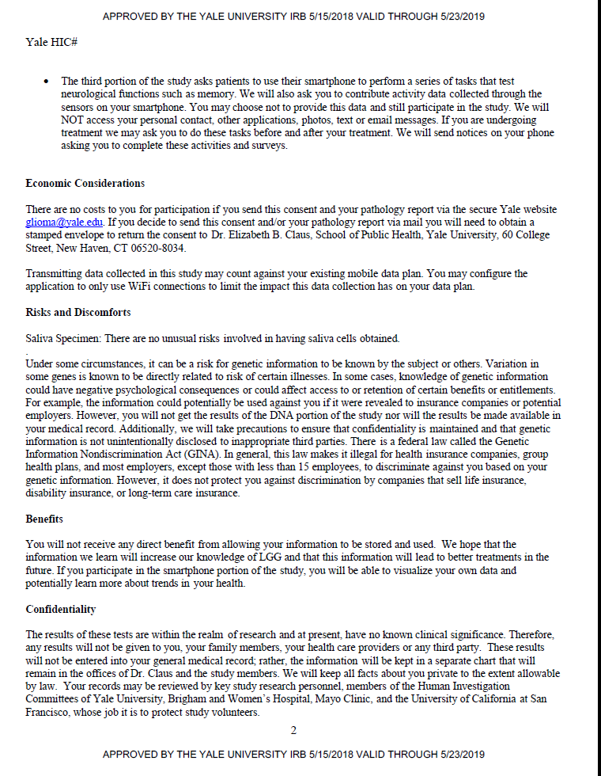
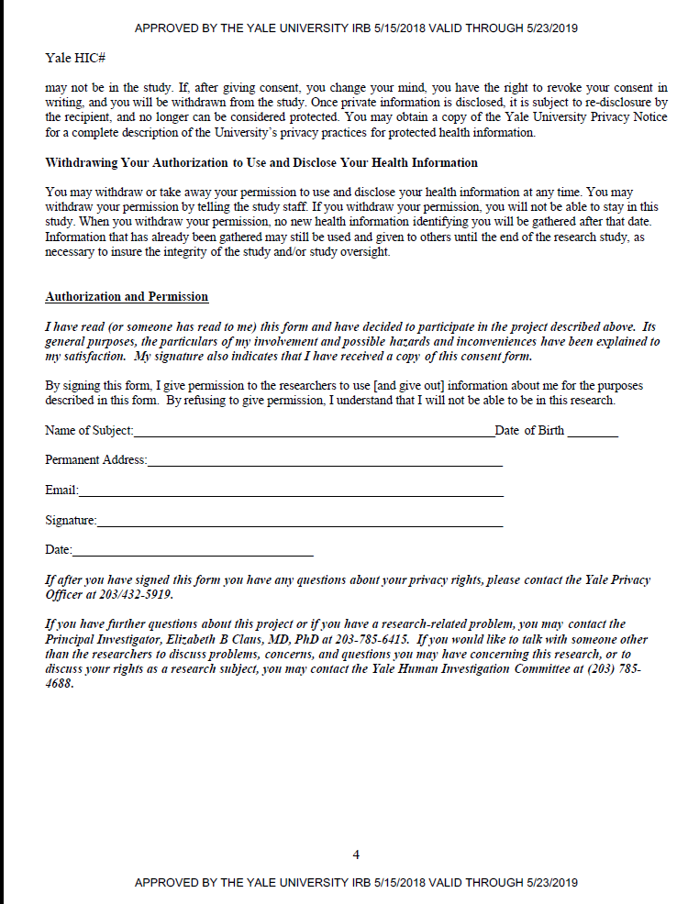

Slide 15
NIH Data Sharing Policy and Implementation Guidelines
Proprietary Data
“Small Business Innovation Research (SBIR) applicants are also to address data sharing in their applications, under the Small Business Act, SBIR grantees may withhold their data for 4 years after the end of the award. The Small Business Act provides authority for NIH to protect from disclosure and nongovernmental use all SBIR data developed from work performed under an SBIR funding agreement for a period of 4 years after the closeout of either a phase I or phase II grant unless NIH obtains permission from the awardee to disclose these data.
Issues related to proprietary data also can arise when cofunding is provided by the private sector (e.g., the pharmaceutical or biotechnology industries) with corresponding constraints on public disclosure. “
Note that some organizations view funding as a contract not a grant.
https://grants.nih.gov/grants/policy/data_sharing/data_sharing_guidance.htm#goals

Slide 16


Process at Yale
Sharing data between Researchers
Work with a Contract Manager, Corporate Contracts
Yale University, Office of Sponsored Projects and IRB team
9. Is the material derived from other materials obtained or purchased from a third party? No 10. What funding supported development of the material? Funding was provided by the Brain Science Foundation, the Meningioma Mommas, and NIH R01 grants CA109468, CA109461, CA109745, CA109473, CA109475, CA052689 and CA151933, and P50CA097257. 11. Is the material subject to any third party agreement or restrictions? No 12. Is the material of potential value? Possible 13. Have you submitted a disclosure to OCR for the material? No 14. Is the material hazardous or a select agent? No 15. To your knowledge, is the material subject to export controls or any other shipping restrictions? No 16. Is the material derived from a human subject or otherwise requires HIC approval? Data are the genotype results from saliva/blood samples drawn from the participants in our meningioma case/control study (Yale IRB Study 0509000560) MODCR00002409

Slide 17
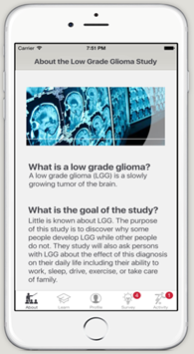
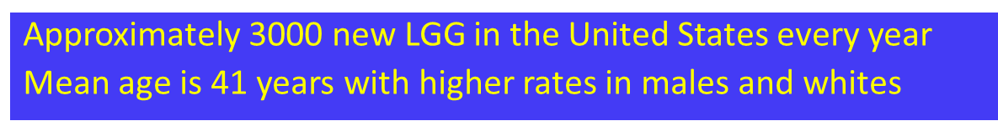
LGG REGISTRY
Significant gaps exist in our understanding of the causes and clinical management of glioma, the most common malignant brain tumor in the United States. One of the biggest gaps is how to best manage low grade (grade II) glioma (LGG) patients.
Want to combine partnership with a national patient organization, social media, and a web-based data collection process to study LGG

Slide 18
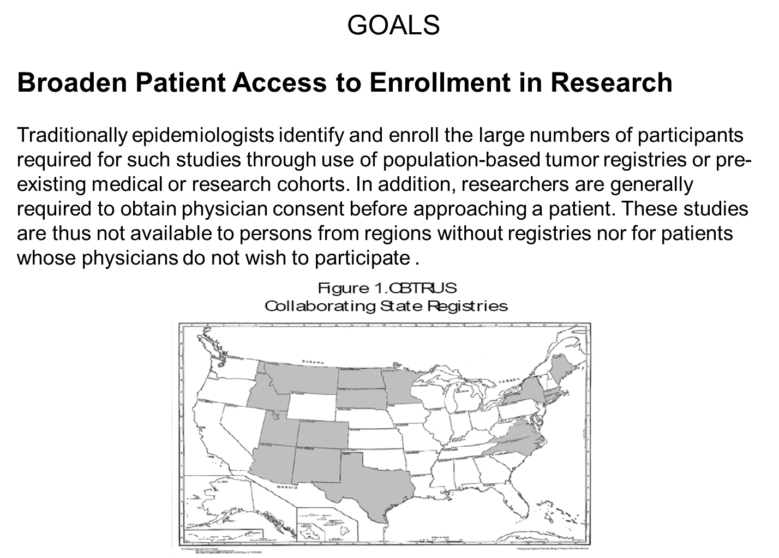

Slide 19
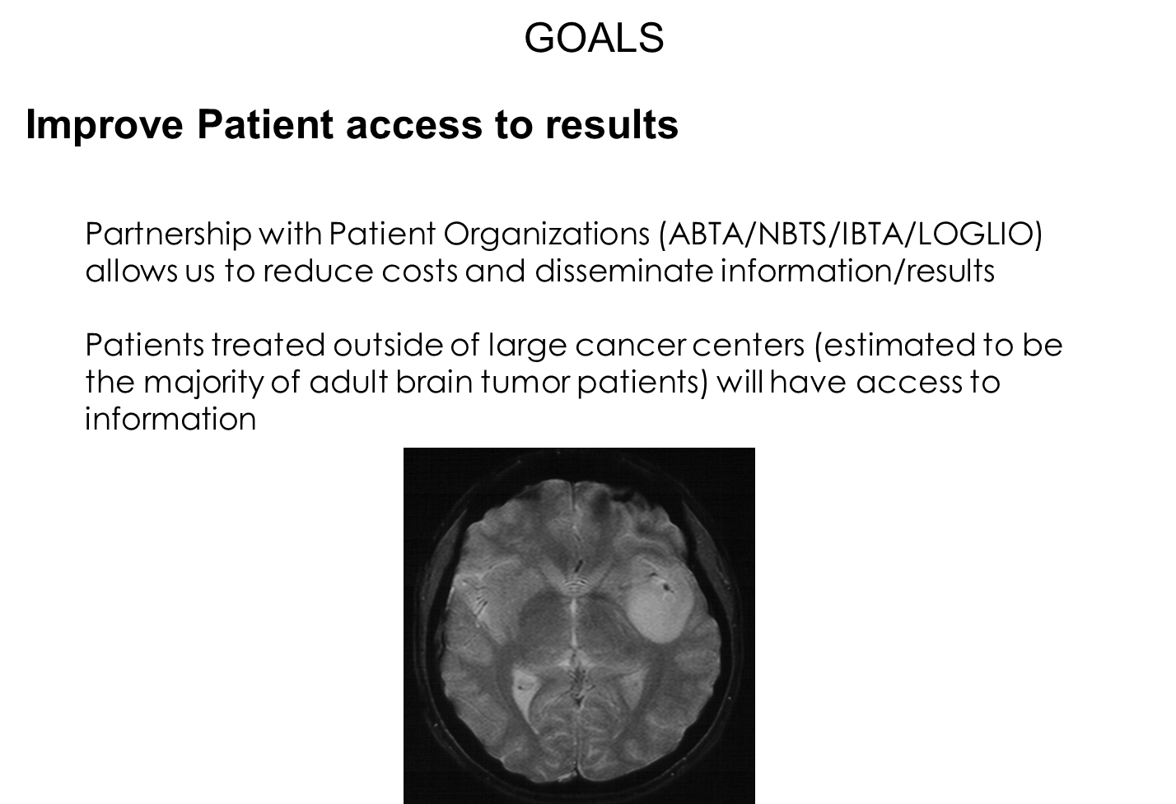
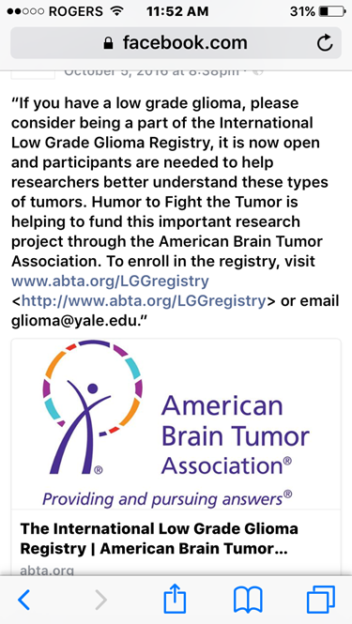

Slide 20
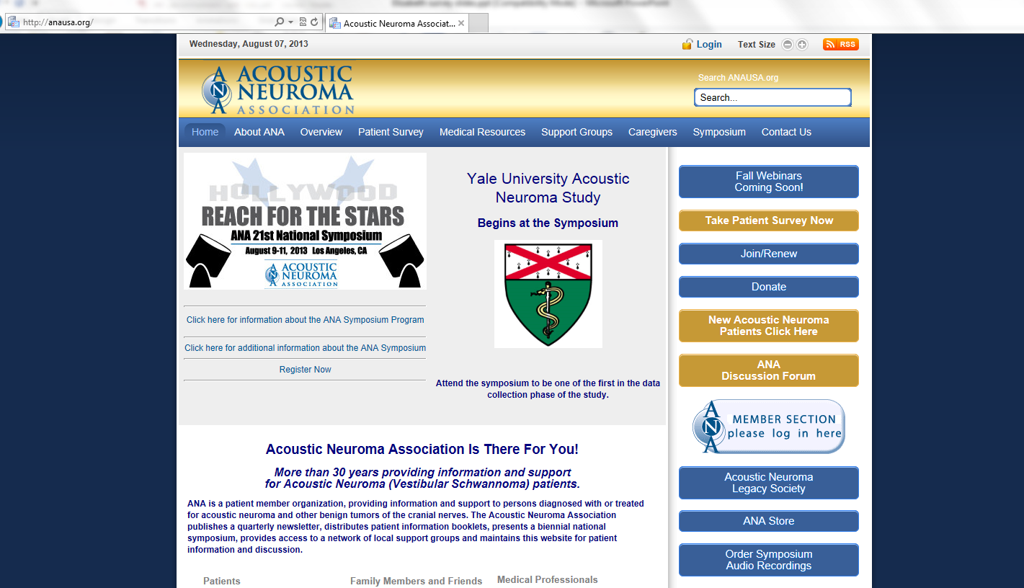
GOALS
Reduce Costs
Our recent effort in such a registry for Acoustic Neuroma revealed a significant cost reduction and was a primarily a function of the reduced need for personnel, paper products, and costs associated with medical record collection. Relative to our previous similar (but registry-based) studies we estimate an average cost of $175 versus $1500-2000 per participant.

Slide 21

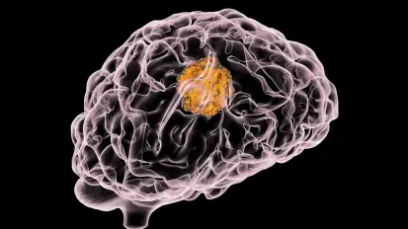
R and the Study of rare disease
Development of a suite of R tools that would allow patient organizations without significant funds to help their members
App to allow patients to more easily enroll in epidemiology studies?
App to allow for patients to learn of clinical trials based on disease characteristics?
Free methods for groups to gather patient data?
And so on…

Slide 22
The Patient speaks
“I implore the authors to consider that while their work is important - I myself am alive due in part to a clinical trial in 2007 - the goal of the entire industry is better health for the people who have the problem; it is NOT for the greater glory of the researcher. I implore the authors to ask their hearts: how can fairness to the analysts of a problem outweigh fairness to the people whose baby, or mother, or anyone else, is in big trouble? I believe researchers should be well compensated for their work, such that they should not depend on subsequent downstream "sales" of the data (because that's what it is, right? selling it again?) achieved by withholding it from others who need it.”
“This is not working. I just hope that my death will not be in vain and someone learns from it so that others don't have to go through this' was what my husband said when it became clear that the new drug combination was not working fast enough for us. He was 36 at the time and this was our second clinical trial (with one EAP in the middle which strictly speaking is no longer a clinical trial). We obviously hadn't made the mistake of some some double-blind, placebo-controlled randomised trial at that point- when your life is at stake, you have little tolerance for scientific constructs more concerned about p-values than saving your life- so we knew that at least it was drugs failing us, not ivory tower-trial design issue.”
“In the era of precision medicine identifying individual risk profiles and combination of risk factors associated with lack of expected effect is the key. Often the pattern of comorbidities in trial patients differs from real-world patients. This is why the expected treatment size effects are inflated. Why hide this information? Patient-level data also enable treatment risk assessment. Drugs are not developed in “one (risk) size fits all” mode. After all who wants to be an “average patient” these days? “
“There is no discussion of additional financial renumeration for the patients who participate in clinical trials. Apparently, only researchers make sacrifices to create RCT data that warrant additional ongoing financial recompense.”
Comments to NEJM 2016;375:405-407

